Slide 1
Guitar Notation with Embedded Media
In realtime

Slide 2
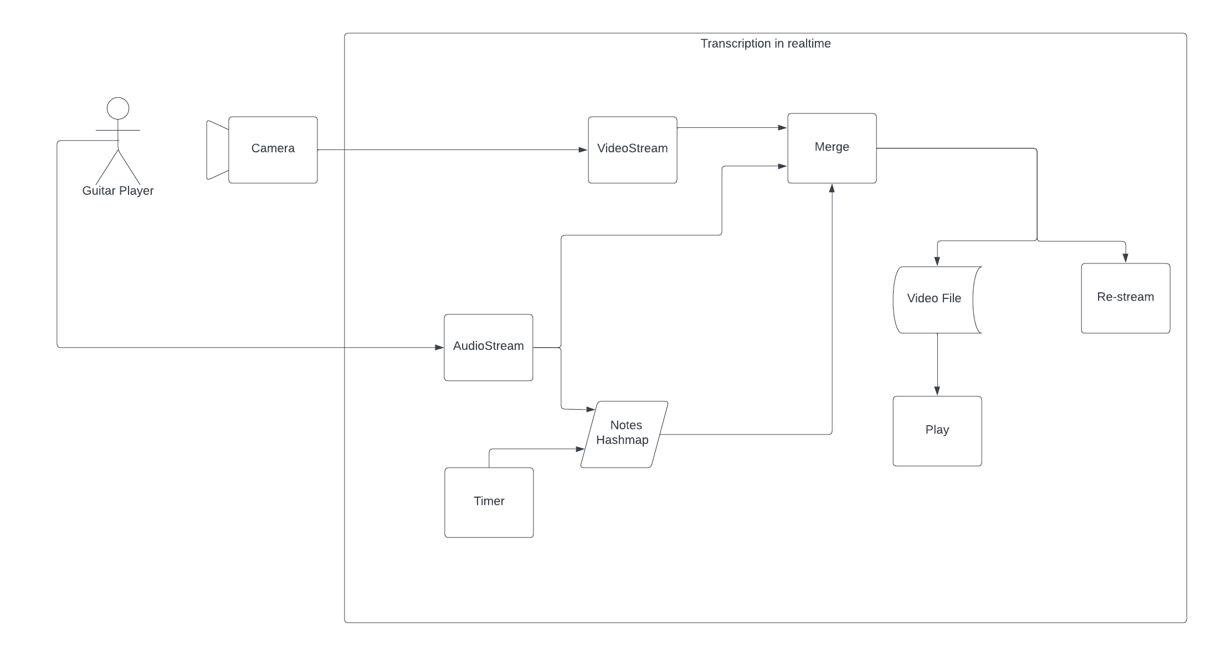

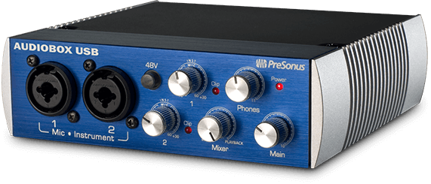
General Overview

Slide 3
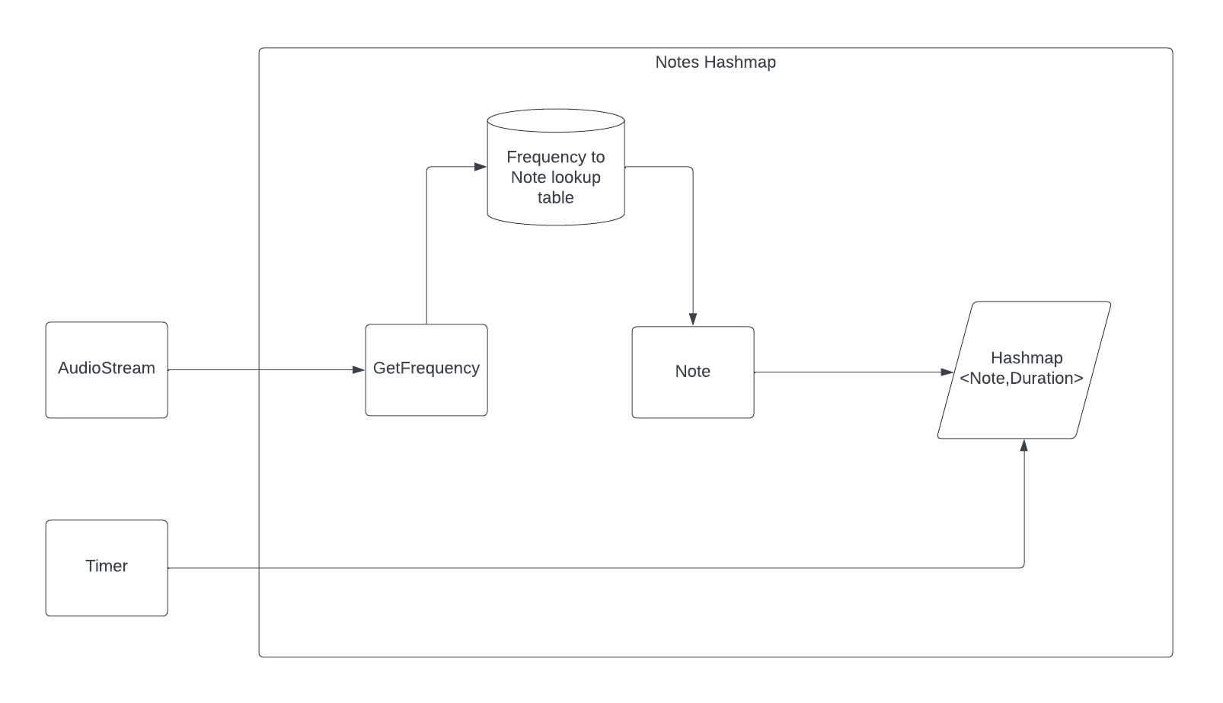
Getting Notes from an AudioStream
{
note: "A4",
frequency: 440,
duration: 200ms
}

Slide 4
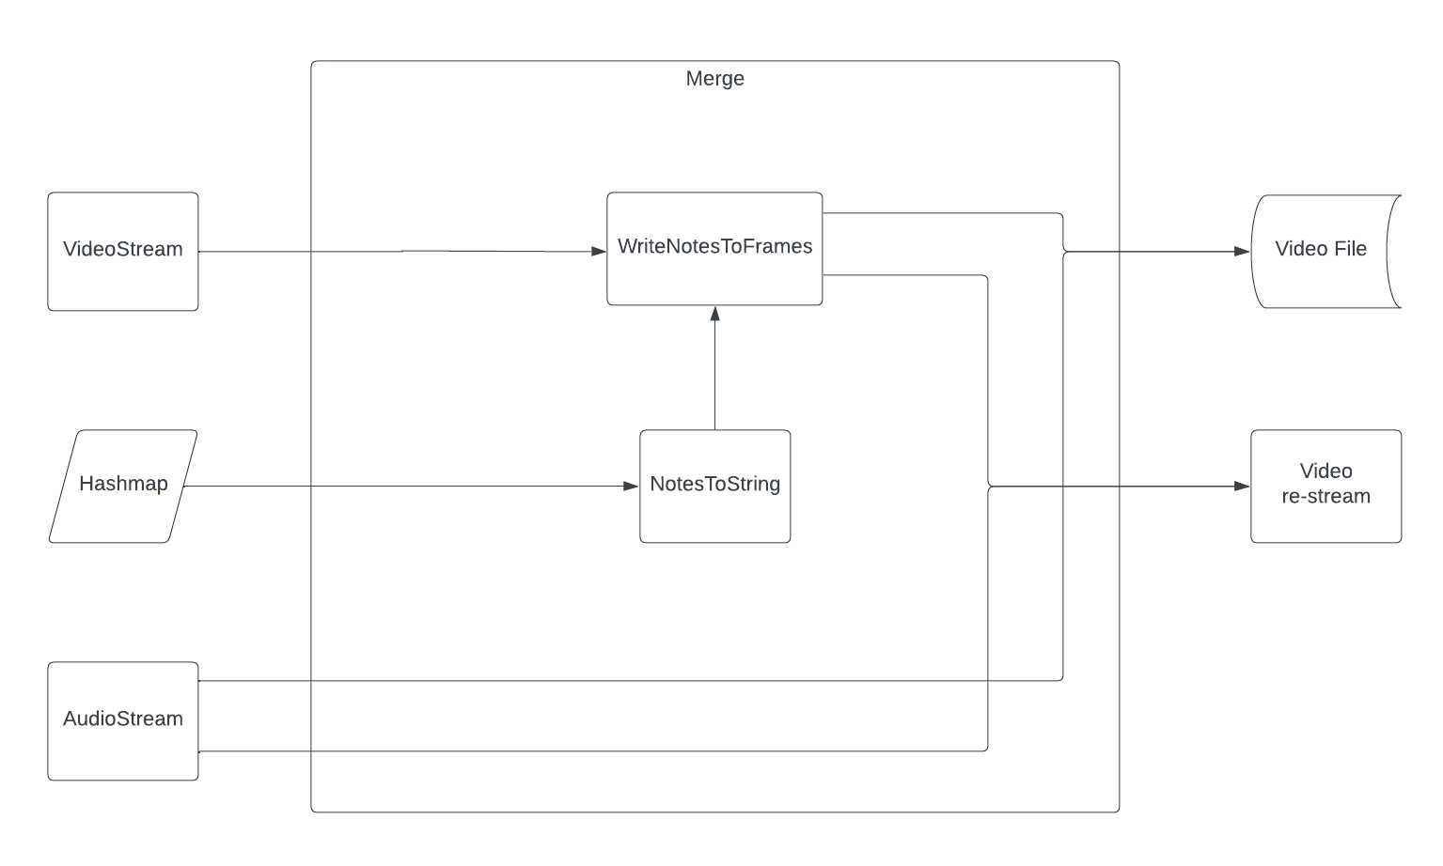
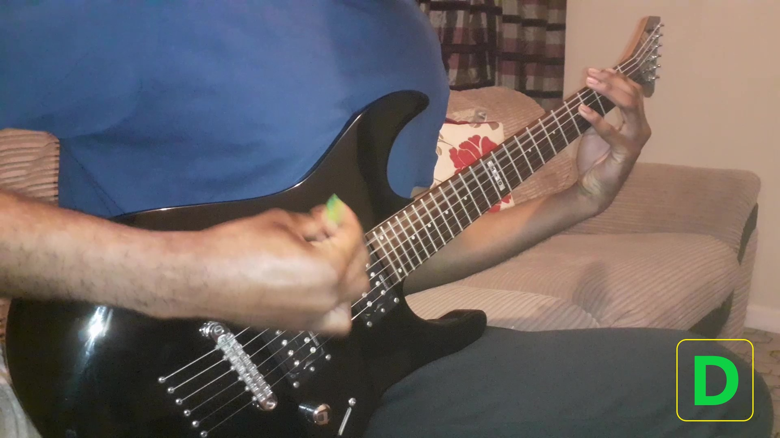
Merging Streams and Notes

Slide 5
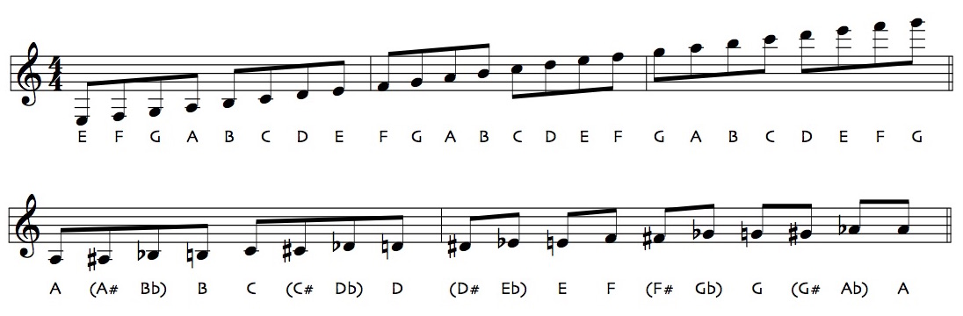
Transcribing for Staff Notation
[{note: “E3”, duration: 62.5}, {note: “F3”, duration:62.5}, ….]

Slide 6
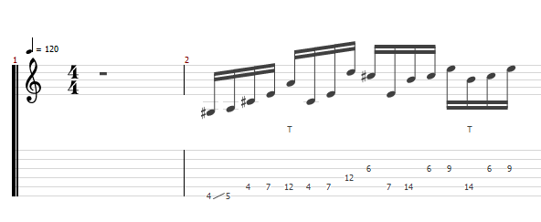
But What About Guitar Tabs???

Slide 7


Slide 8
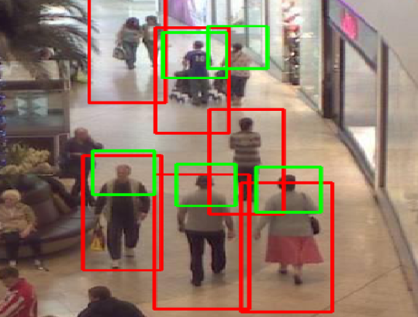
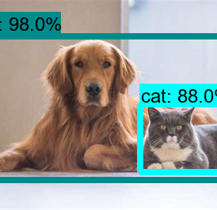
Object Detection and Tracking

Slide 9
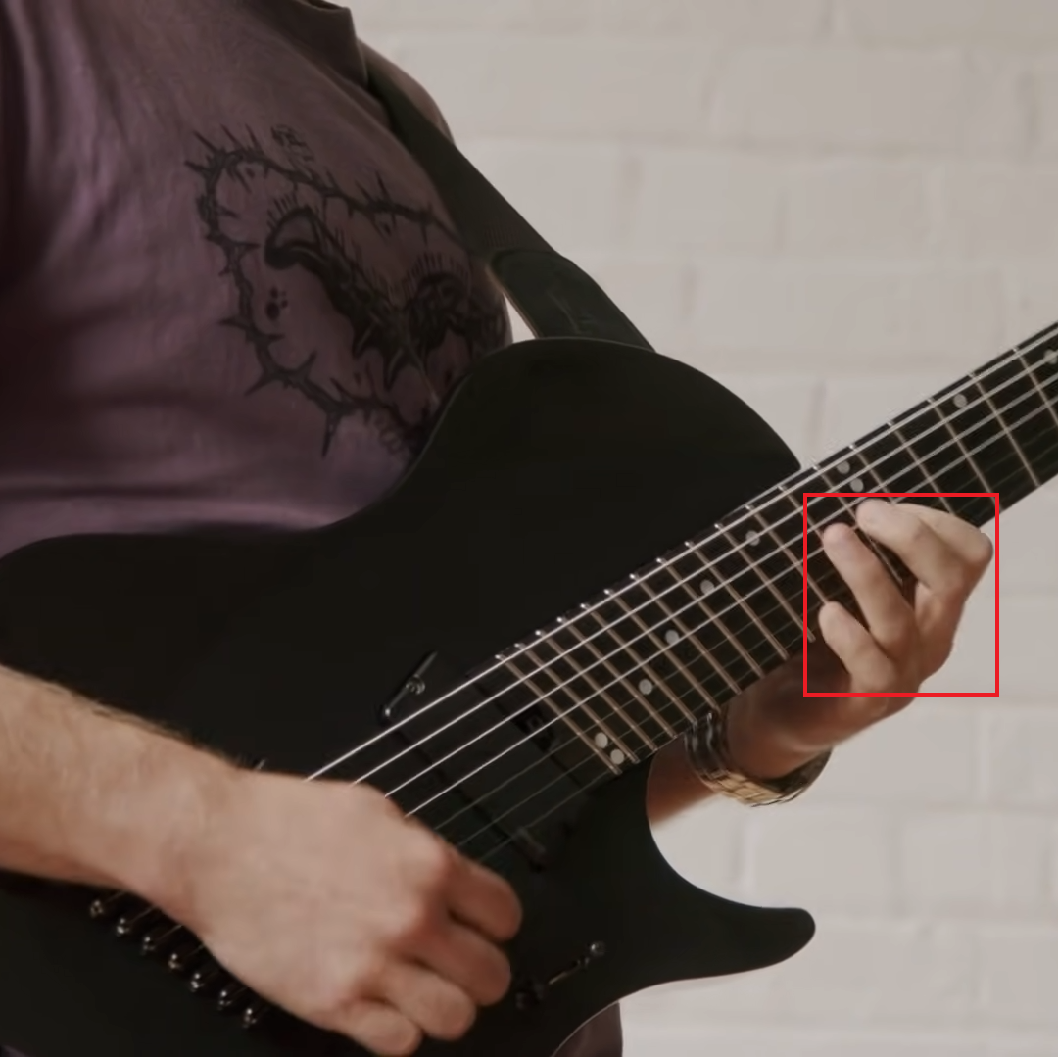
How AI will be Incorporated

Slide 10
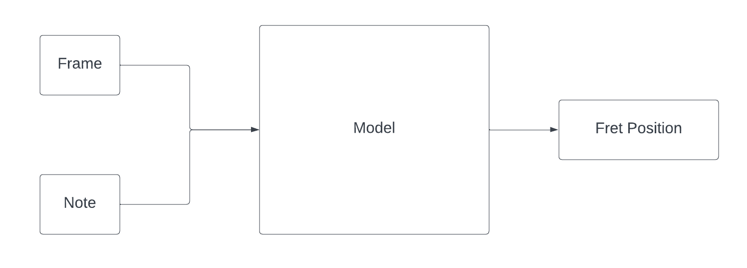
Model Overview

Slide 11
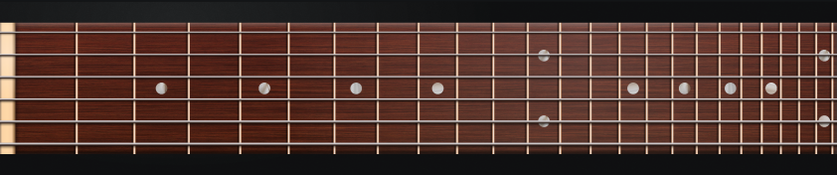
0 | 0 | 0 | 0 | 0 | 0 | 0 | 0 | 0 | 0 | 1 | 1 | 1 | 1 | 1 | 0 | 0 | 0 | 0 | 0 | 0 | 0 | 0 | 0
0 | 0 | 0 | 0 | 0 | 0 | 0 | 0 | 0 | 0 | 1 | 1 | 1 | 1 | 0 | 0 | 0 | 0 | 0 | 0 | 0 | 0 | 0 | 0
0 | 0 | 0 | 0 | 0 | 0 | 0 | 0 | 0 | 0 | 0 | 1 | 1 | 1 | 0 | 0 | 0 | 0 | 0 | 0 | 0 | 0 | 0 | 0
0 | 0 | 0 | 0 | 0 | 0 | 0 | 0 | 0 | 0 | 0 | 1 | 1 | 0 | 0 | 0 | 0 | 0 | 0 | 0 | 0 | 0 | 0 | 0
0 | 0 | 0 | 0 | 0 | 0 | 0 | 0 | 0 | 0 | 0 | 0 | 0 | 0 | 0 | 0 | 0 | 0 | 0 | 0 | 0 | 0 | 0 | 0
0 | 0 | 0 | 0 | 0 | 0 | 0 | 0 | 0 | 0 | 0 | 0 | 0 | 0 | 0 | 0 | 0 | 0 | 0 | 0 | 0 | 0 | 0 | 0

Slide 12
{note: “G3”}
0 | 0 | 0 | 0 | 0 | 0 | 0 | 0 | 0 | 0 | 1 | 1 | 1 | 1 | 1 | 0 | 0 | 0 | 0 | 0 | 0 | 0 | 0 | 0
0 | 0 | 0 | 0 | 0 | 0 | 0 | 0 | 0 | 0 | 1 | 1 | 1 | 1 | 0 | 0 | 0 | 0 | 0 | 0 | 0 | 0 | 0 | 0
0 | 0 | 0 | 0 | 0 | 0 | 0 | 0 | 0 | 0 | 0 | 1 | 1 | 1 | 0 | 0 | 0 | 0 | 0 | 0 | 0 | 0 | 0 | 0
0 | 0 | 0 | 0 | 0 | 0 | 0 | 0 | 0 | 0 | 0 | 1 | 1 | 0 | 0 | 0 | 0 | 0 | 0 | 0 | 0 | 0 | 0 | 0
0 | 0 | 0 | 0 | 0 | 0 | 0 | 0 | 0 | 0 | 0 | 0 | 0 | 0 | 0 | 0 | 0 | 0 | 0 | 0 | 0 | 0 | 0 | 0
0 | 0 | 0 | 0 | 0 | 0 | 0 | 0 | 0 | 0 | 0 | 0 | 0 | 0 | 0 | 0 | 0 | 0 | 0 | 0 | 0 | 0 | 0 | 0
G3 located at fret 15

Slide 13
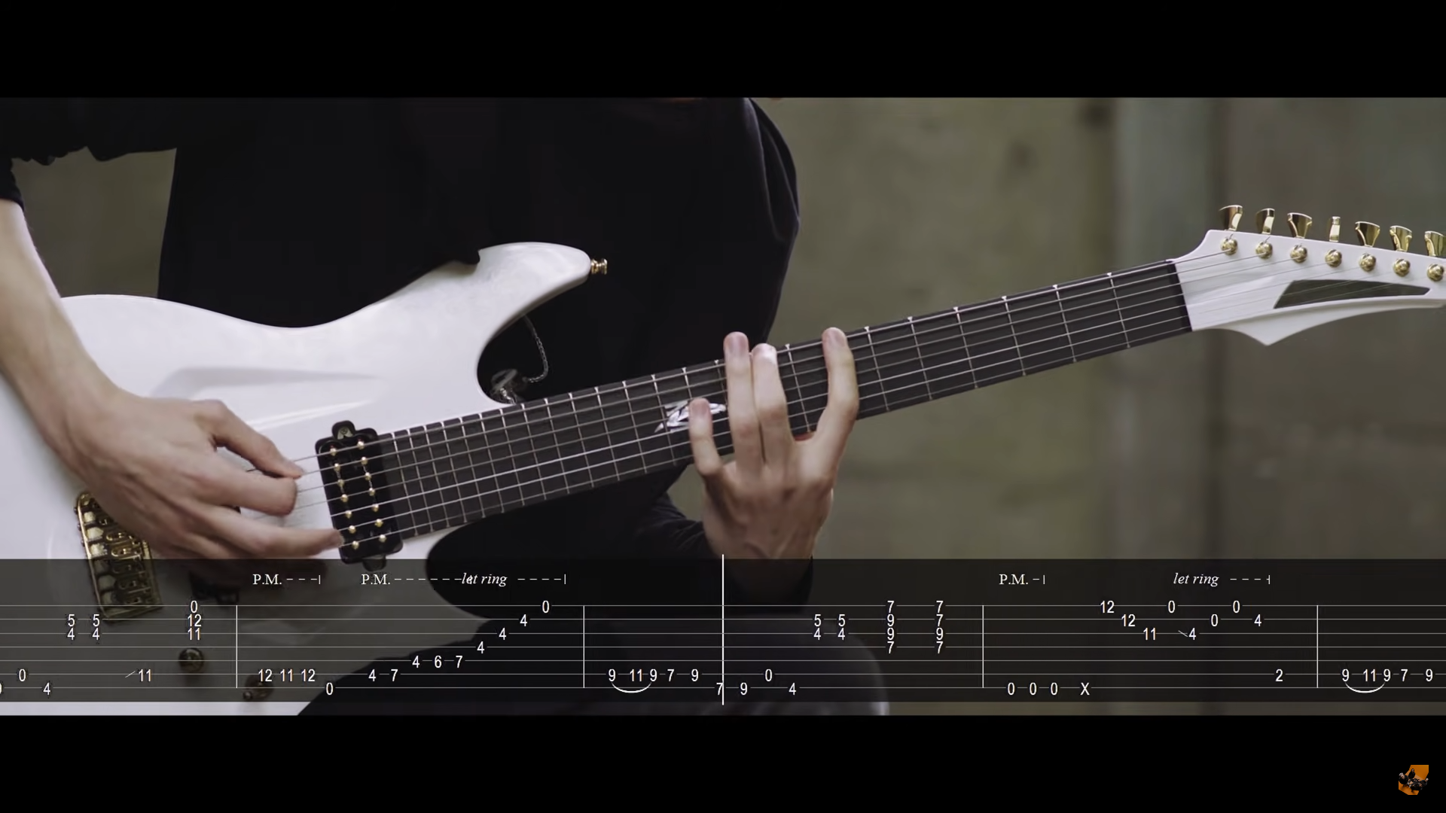
Result

Slide 14
Demo

